Slide 1
Spring 6.0 From Beginner to Guru

Slide 2
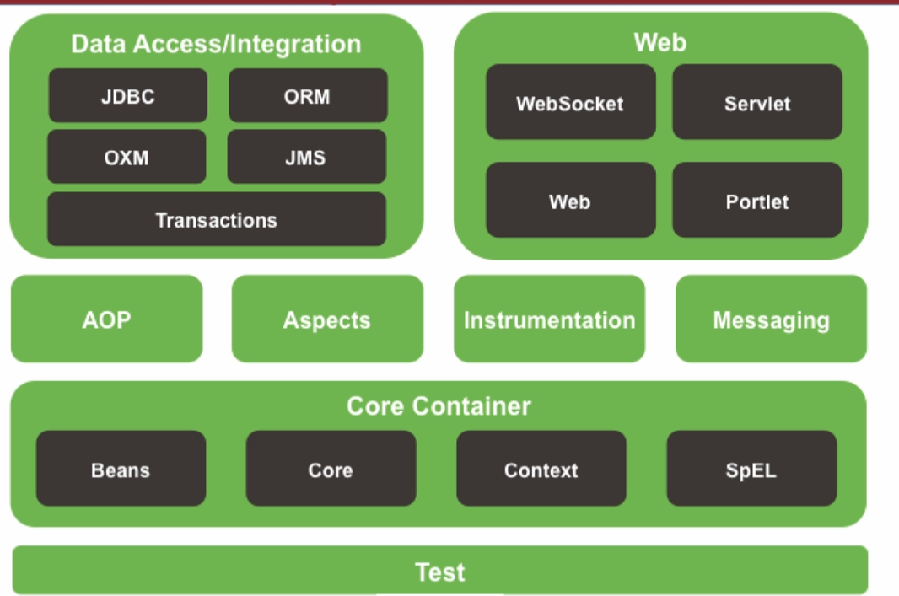
Introduction to Spring
Components
  Spring Boot -- Auto-configuration – If a specific library is on the classpath
  Projects
    Spring Data – Collection of project for persisting data to SQL and
    NoSQL databases
    Spring Cloud
    Spring Security – Authentication and Authorization
    Spring Integration – Enterprise Integration Patterns
    Spring Batch – Batch Processing
    Spring State Machine – Open Source State Machine

Slide 3
Spring Initializer
For the project
  Project name spring-6-webapp
  Use jar ( fat jar ) and Java 17
  Dependencies
    Lombok
    Spring Web
    Spring Data JPA
    H2 Database ( in memory database )

Slide 4
JPA Relationships
Equity In Hibernate
Mapped by – The property name of other used in the relationship
@Join Table will join the table based on specific @Join Columns
Equity in Hibernate
  Set Equal/Hashcode method since Hibernate use it to determine object quity
  Strategies either id or the entire class

Slide 5
Initialization Data with Spring
Introduction to H2 Database Console
Introduciton of Spring MVC
CommandLineRunner – provided by Spring Boot to execute the run method
  Every time Spring Starts up
Introduction to H2 Database Console
  If you included Spring Developer Tools it is enabled by default
  Find the URI that starts with jdbc:h2 and select that string
  Url: http://localhost:8080/h2Console
  Put the String into the JDBC URL
Introduction to Spring MVC
  Definitions
    Model – Simple POJO passed between view and the business logic
    View – Data requested by the client.

Slide 6
Thymeleaf Templates
Introduction to Thymeleaf
  https://medium.com/thymeleaf-basics-concepts/thymeleaf-1ef952db0740

Slide 7
Solid Principal of OOP
5 Principles
  S Single Responsibility Principal
    Every class should have a single responsibility
      There should never be more than one reason for a class to change
    Classes should be small
    Avoid God Classes
    Split big classes into smaller classes
  O Open Closed Principal
    Your classes should be open for extension, but closed for modification
    Be able to extend a classes behavior without modifying it
    Use private variables with getters and setters – only when you need them
    Use Abstract Base Classes
  L Liskov Substitution Principal
    Objects in a program would be replaceable with instances of their subtypes without altering the correctness of the prgram
    Violations will often fail the “Is A “ Test : A square is a rectangle , but a rectangle is not a square
  I Interface Segregation Principle
  D Dependency Inversion Principal

Slide 8
Solid Principal of OOP
  I Interface Segregation Principle
    Make sure fined grained interface that are not client specific
    Keep your components focused and minimize dependencies between them
    Relationship to the Singe Responsibility Principle
    Avoid God Interfaces
  D Dependency Inversion Principal
    Abstractions should not depend on the details and details should not depend the abstraction
      Should work together and not be tightly coupled
    Higher and Lower level object depended on the abstract interaction
    Not the same as dependency injection

Slide 9
The Spring Context
Spring Test Context
Default Behavior for Spring Boot
  Configures Spring for annotated ( ex. @Compoent) components I the package it is in and below
Spring Text Context

Slide 10
Basics of Dependency Injection
Basics of Dependency Injection
  Dependency Injection is where a needed dependency is injected by another object
  Can be instantiated via constructor or after via setter
  Types of Dependency Injection
    By class properties – Don’t use very hard to test
    By Setters
    By Constructor
  Object cannot exist without that dependency being passed into it
  Concrete classes vs interfaces
    Interface highly preferred
    Allows runtime to decide implementation to inject
    Follows interface segregation principle of SOLID
    Allows cost to be more testable and Mocks become more trivial

Slide 11
Basics of Dependency Injection
Inversion of Control
  A technique that allows dependencies to be injected at runtime
  Dependencies are not predetermined since it allows the framework to
  |compose the application by controlling which implementation in injected
    H2 in memory data source or MySQL data source
Inversion of Control vs Dependency Injection
  Dependency Injection refers to the composition of your classes
  IoC is the runtime environment of you code
    Control of Dependency Injection is inverted to the framework
    Spring in control of the injection of dependencies
Best Practices
  Final properties for injected components
    Declare private final and initialize in the constructor
  Whenever practical code to an interface

Slide 12
Dependency using Spring Framework
Primary Beans
Using Qualifiers
Spring Profiles
When doing setter injection make sure the setter has the @autowired
Primary Beans
Using Qualifiers
Spring Profiles
  If profile is defined using @ActiveProfile then a exception will be generated.
  For default profile the second parameter of @Profile second parameter must be default00

Slide 13
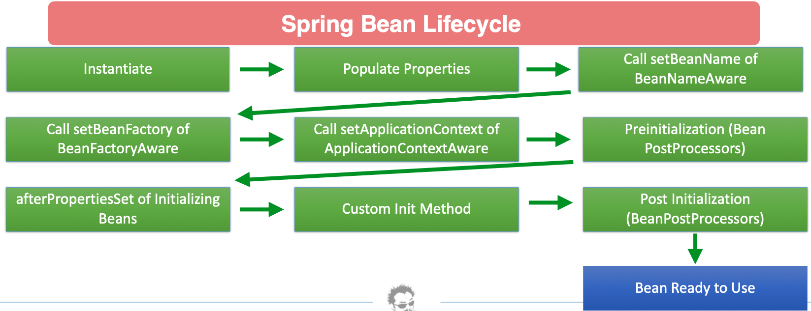
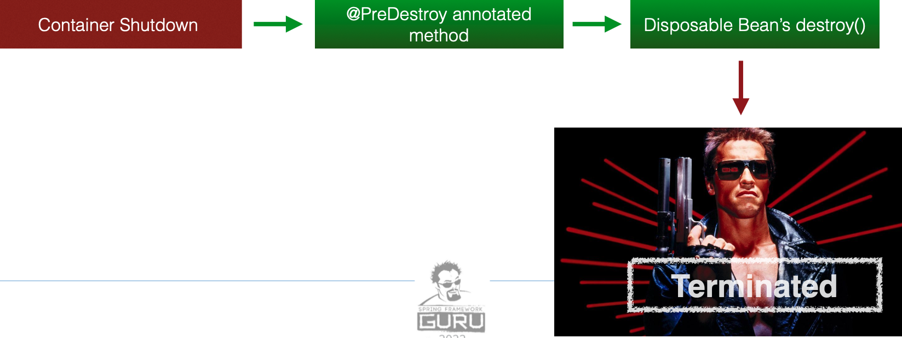
Spring Bean Life Cycle
Bean Processors are callbacks that we can hook into.
very rare that you need to use
Has Two interfaces you can implement for call back events
  intializingBean.afterpropertiesSet
    @PostConstruct
    Called after the properties are set, but bean has
    not been returned to the object
  DisposableBean.destroy()
    @PreDestroy
    Called before bean is destroyed by the container
Beans Post Processors – Tap into the Spring Lifecycle and interact
with beans as they are processed
  Example Use - Create a 3rd Party Object that needs to be created, put into the context
  and updated ( non spring managed component
  Called for all beans in context
  implement BeansPostProcessor
    postProcessBeforeInitialization – Called before bean initialization method
    postProcessAfterInitialization – Called after bean initialization

Slide 14
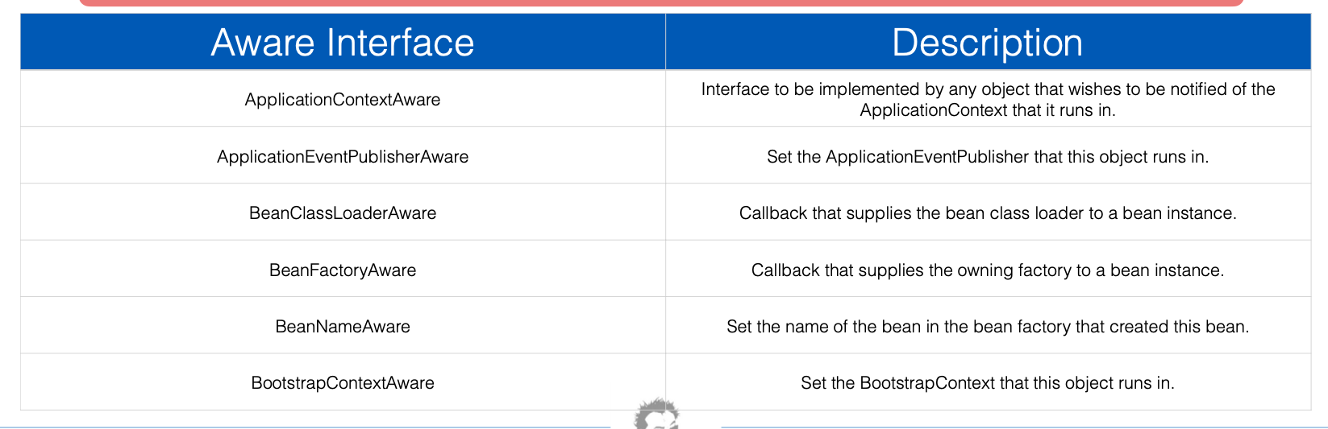
Spring Bean Life Cycle
Aware interfaces
  Used to access the Spring Framework Infrastructure
  largely used in the framework
  Rarely used by Spring Developers
  Review extensions of the aware interfaces for current interfaces

Slide 15
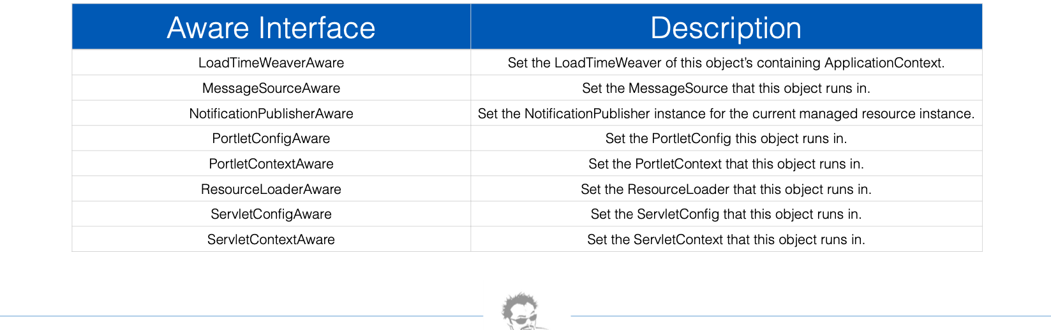
Spring Bean Life Cycle

Slide 16
HTTP Protocol
Started as a telnet friendly protocol
  Use ssh instead of telnet
HTTP History : Version 1.0 from 1991 to 1995
  Contain request line with HTTP Version number followed by headers such as User Agent
  Response status followed by header such as Content-type, Content-length, Expires etc..
  Http Standard were developed by IETF and W3C designed a design document
HTTP/1.1. release in 1997 and updated in 1999/2014
  Added support for keep alive connection, chunked encoding transfers, byte range request, transfer encoding and request pipelining
  Added later : Request Added encoding, charset, cookies and response added encoding, charset and cookies
HTTP 2.0 Standardized in 2015 (Performance release)
  Transport performance was a focus
  Improved load speed by lower latency and higher throughput
  Helps in scaling applications.
  High level of compatibility with HTTP/1.1 ( mainly low level changes that developers won’t recognizine )

Slide 17
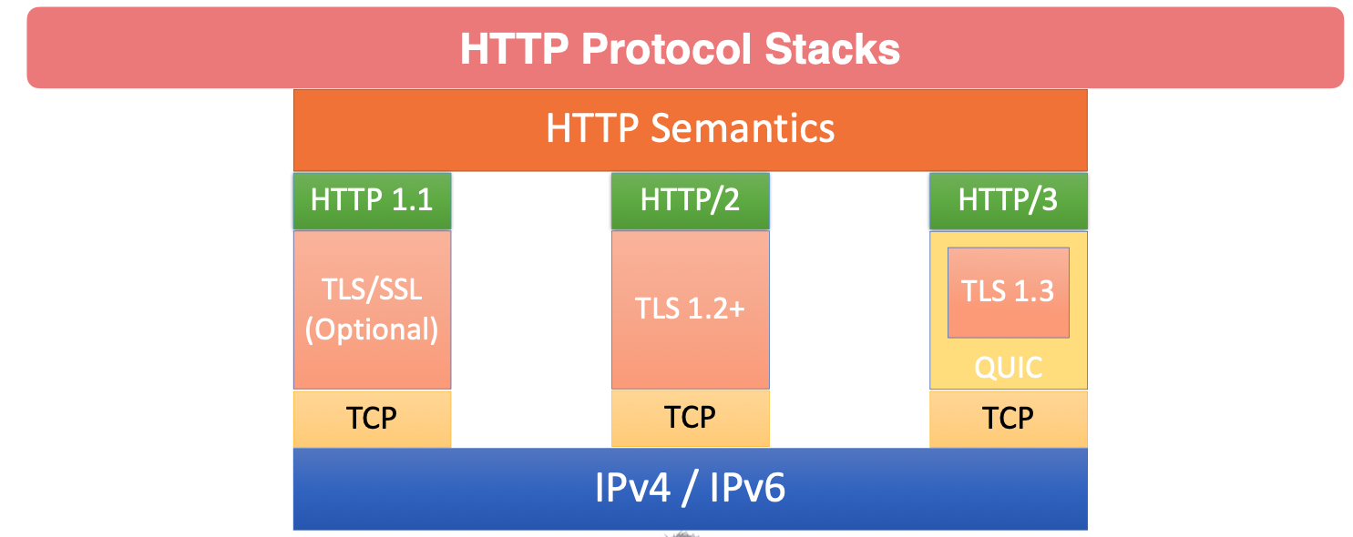
HTTP Protocol
HTTP/3
  Builds on concepts of HTTP/2
  Most significant is use of the QUIC network protocol
  rather than TCP
For the developers the calls, the status codes and methods are all the same.

Slide 18
HTTP Request Methods
Request Methods (verbs) indicate the desired action to be performed.
Get
  Request for a resource ( html file, javascript, file image)
  Used when you visit a website
Head
  Ask for meta information without the body
Post
  Used to post data to the server ( insert new data )
    An example would be a checkout form
  Post is a create request
Put
  Is a request for the enclosed entity be stored at the supplied URI. If the entity exist it is expected to be updated
  Put is a create or update request

Slide 19
HTTP Request Methods
Delete
  A request to delete the specified resource
  Not supported by the HTML Standard.
Trace
  Will echo the received request
  Can be used to see if the request was altered by intermediate server
    Example : Proxy Servers can change the request along the way
Options
  Returns the HTTP Methods support by the server for the specified URL
Connect
  Converts the request to a transparent TCP/IP tunnel typically fro HTTPS through an unencrypted HTTP Proxy
  The author has never seen a direct use for
Patch
  Applies partial modifications to the specified resource

Slide 20
HTTP PROTOCOL
Safe Methods
  Considered safe to use because they only fetch information
  Do not cause changes to the server unless you are returning dynamic data
  Get, Head Options and Trace are all Safe Methods
Idempotent Methods
  A quality of an action such that repetitions of the action have no further effect on the outcome
  put and Delete are Idempotent Methods
  Safe Methods ( Get, Head, Trace, Options ) are Idempotent
  Being truly idempotent is not enforced by the protocol, but part of the standard
Non-Idempotent Methods
  Post is not Idempotent
  Multiple post are likely to create multiple resource
    Example. Ever seen websites asking you to click submit only once
Cacheable : Get, Head, Post, Patch
Non Cacheable : Put, Delete, Connect Options, Trace

Slide 21
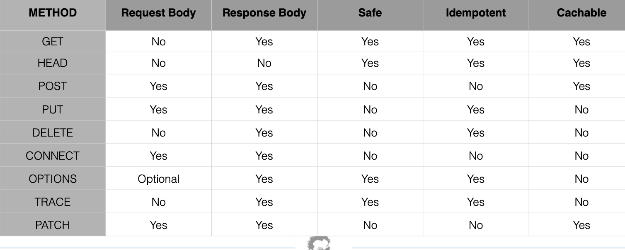
HTTP Protocol

Slide 22
HTTP Protocol
Status Codes
  100 Informational
  200 Indicates successful request
  300 series are redirections Example a website has moved
    They are rarely used in Rest Services
  400 client errors
  500 server side errors
Common HTTP Status Codes
  200 Okay
  201 Created
  204 Accepted
  301 Move Permanently Will get the new location back,
  400 Bad Request Example a media type that the media does not accept – Bad Data Received
  401 Not Authorized User Authentication, not authorized
  404 Not Found
  405 Method Not Allowed Method has not been found for the HTTP Verb and Context Path
  500 Internal Server Error
  503 Service Unavailable

Slide 23
Restful Web Services
REST – Representational State Transfer
  Representation – Typically JSON or XML
  State Transfer – Typically HTTP
Rest APIs use HTTP verbs to create, manage and delete server resources
  Data Structures represented by JSON or XML
  HTTP Status Code are used to communicate success, failure or errors
  Not a standard unlike SOAP
  kubectl get all --selector app=myweb
Restful Terminology
  Verbs : HTTP Methods manages the payload of the action ( JSON/XML)
  URI – Uniform Resource Identifier – A unique string identifying a resource – http://www.example.com
  URL – Uniform Resource Locator – A URI with network information – http://www.example.com/books/1
  Idempotent
  States – Does not maintain any client state
  HATEOAS – Engine of the application state
    Rest Client should use server provided links dynamically to discover all the available action and resources it needs.
    The server responds with text that includes hyperlinks to other actions that are currently available

Slide 24
Richardson Maturity Model
Used to describe the quality of the Restful Service
Levels
  Level 0 : The swap of pox – Examples RPC, SOAP, XML-RPC
    Plain old XML
    Use Implementing protocol as a transport protocol
    Uses one URI and one method
    Breaks large service into distinct URIs
  Level 1 : Resources
    Use Multiple URIs to identity specific resources – Example http://www.example.com/product/1234 and http://www.example.com/product/4567
    Still uses a single method get
  Level 2 : HTTP Verbs ( used with URIs for desired actions )
    Examples : Get /products/1234 to return data for product 1234
    Examples : Put /product/1234( with XML Body ) to update data for product 1234
    Most common in practical use
    Introduces Verbs to implement actions
  Level 3: Hypermedia Controls – Representation now contains URIs which may be useful to consumers
    Help to explore the resource ( Spring provides an implementation of HATEOS)
    No clear standard at this time.
    provides discoverability, making API more self documenting

Slide 25
Spring Framework and Restful Services
Web Frameworks
  Spring MVC
    Has robust support for traditional Web Applications
    Based on traditional Java Servlet API – Blocking and non reactive
    Legacy
  Spring Webflux
    Uses project Reactor to provide reactive web services
    Do not use Java Servlet API and is non blocking
    Follows very close to the configuration model of Spring MVC – Easy Transition
  WebFlux.fn – A functional programming model used to define endpoint
    Alternate to annotation based configuration
    Designed to rapidly and simple define microservices endpoints

Slide 26
Spring Framework and Restful Services
Web Client
  Spring Rest Template
    RestTemplate is Spring’s library for consuming RESTFUL web services
    Highly configurable
    Getting ready to be deprecated
  Spring Web Client
    Reactive Web Client
    uses Reactor and Netty – A non blocking HTTP Client Library
  Should be fluent in both
Marshaling and Unmarshaling
  Convert Java POJO to JSON or XML – Marshalling
  Convert JSON or XML to Java Objects called Unmarshalling
  Spring boot configures Jackson to facilitate Marshaling and Unmarshaling, but support other libraries

Slide 27
Spring Framework and Restful Services
SPA – Single Page Applications
  Frameworks : Vue, ReactJS, AngularJS, EmberJS
  The frameworks are decoupled from Spring via the HTTP/JSON or XML Layer ( for the Front End and Back End )
  All of the these frameworks can consume RESTful APIS
  Server side can be Spring Boot, .NET, Ruby on Rails – The restful API abstracts the implementation

Slide 28
Project Lombok Features
How Lombok works
  Hooks in via the Annotation processor API
    The AST ( raw source code ) is passed to Lombok for code generation before the java compile continues
    Thus, produces property compiled java code in conjunction with the Java Compile
  target/classes’ you can view the compile class files
  Intellij will decompile to show you the source code
  If you need a custom setter just write the setter and Lomok will not create that setter
Project Lombok and IDE’s
  Since compile code is change and source files are not IDE’s can get confused by this
Features
  val local variables declared final
  var mutable local variables
  @NonNull Null Check will throw NPE if parameter is null

Slide 29
Project Lombok Features
@cleanup Will close() on resource in finally block
@Getter Creates getter methods for all properties
@Setter Create setter for all non-final properties
@ToString
  Generate String of classname and each filed separated by commas
  Optional parameter to include field names
  Optional parameter to include call to the super toString method
@EqualsAndHashCode
  Generates implements of equals (Object Other) and hashCode()
  By default will use all no-static non-transient properties
  Can optionally exclude specific properties
@NoArgsConstructor
  Generates no args constructor
  Will cause compiler error if there are final fields
  Can optionally force which will initialize final fields with 0 / false /null

Slide 30
Project Lombok Features
@RequiredArgsContructor
  Generates a constructor for all fields that are final or marked with @NonNull
  Constructor will throw a NullPointerException if any @NonNull fields are null
@All Args Constructor
  Generates a constructor for all properties of class
  Any @NonNull properties will have null checks
@Data
  Generates typical boilerplate for POJOs
  Combines, @Getter, @Setter, @ToString, @EqualsAndHashCode, @RequiredArgsConstructor
  No constructor is generated constructors have been declared
@Value
  The immutable variant of @Data
  All fields are made private and final by default
@NonNull
  Set on parameter of method or constructor and a NullPointerException will be thrown if parameter is null

Slide 31
Project Lombok Features
@Builder
  Implements the builder patter for object creation
  ex. Person.builder(“Adam Savage”).city(“San Francisco”).job(“MythBusters”).job(“UnchainedReaction”).build()
@SneakyThrows
  Throw Checked exceptions without declaring in calling method’s throw clause
@Syncronized
  A safer implementation of Java’s synchronized
@Getters(lazy = true) for expensive getters
  Will calculate value first time and cache
  Additional gets will read from cache
@Log – Crate a Java util logger
@Slf4j – Creates a generic logging facade
  Spring Boot’s default logger is LogBack
  SLF4j is a generic logging facade

Slide 32
HTTP Client
Spring Developer Tools
Set Header on HTTP Response
Found in tools→ Intellij
Spring Developer Tools
  Live Reload for Web Applications
  Restart Springboot when the class files change
    For the ultimate Edition
      Edit Configuration – Run Options – Update Classes and Resources
    Good for small changes and cheats
HTTP Post
  ResponseEntity -- Extension of HttpEntity that adds an HttpStatusCode status code
    HTTPEntity -- Represents an HTTP request or response entity, consisting of headers and body.
    HTTPStatusCode --
Set Header on HTTP Response
  Use : When creating the object return the new location in the HTTP Response Header Location Attribute.
Note on Put and Post – For Post the whole object is needed. For the Put not all fields need to be named. -- Check this one out.

Slide 33
Introduction to testing with MVC
Unit Tests
  ideal coverage is 70 to 80 percent
  Should be small and execute very fast and light weight
  Should have no external dependencies
    Ex. no database, no Spring Context
Integration test
  Designed to test behaviors between objects and parts of the overall system
  Much large in scope
    Can include the Spring Context, message brokers
  will run much slower than unit test
Functional Tests
  Application is live, likely deployed in a known environment
  Functional touch points are tested
    Using a web driver, calling web services, sending and receiving messages

Slide 34
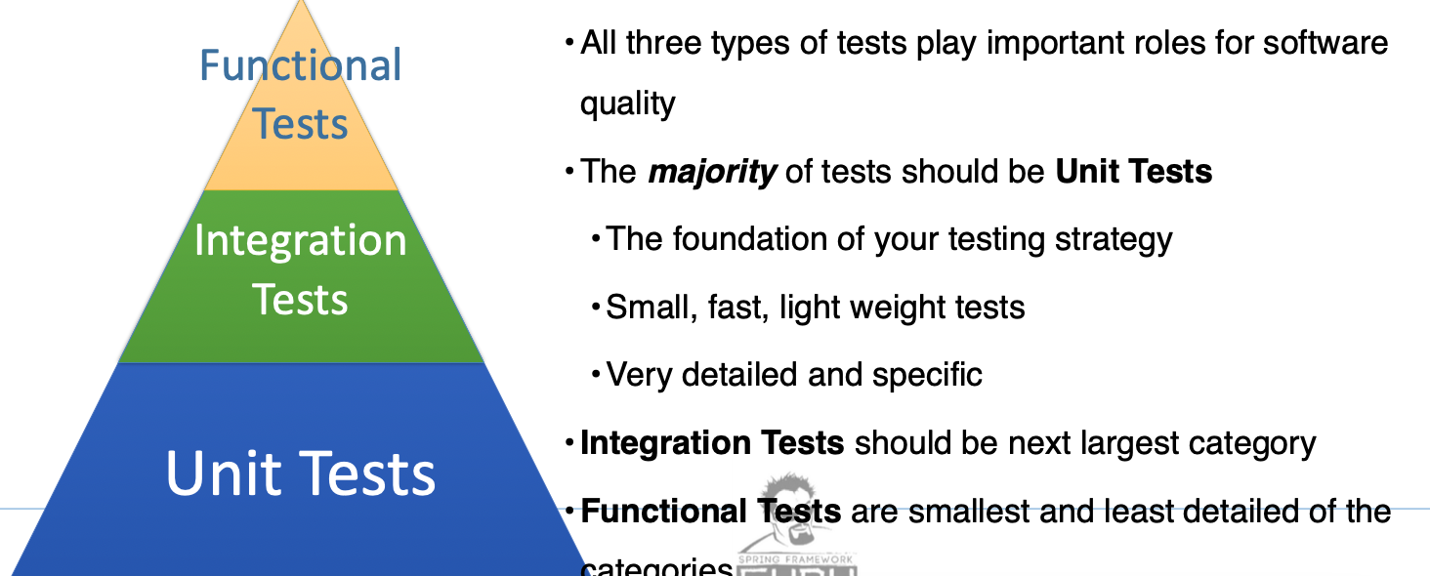
Introduction to testing with MVC
Testing Hierarchy
Testing Spring MVC Controllers is Tricky
  Controllers have a high degree of integration with the Spring MVC
  Framework
    Request path and HTTP Method decides which method to invoke
    Path Variable are parsed from path
    JSON is bound to POJOs
    Response is express as HTTP Response
  Junit test are not sufficient to test the framework interaction
Spring Mock MVC is a testing environment for testing Spring MVC
Controllers
  Provides mocks of the servlet environment
  HTTP Request / Response, Dispatcher Servlet
  Simulates the execution of controller as if it was running under Spring with Tomcat
Can be run with or without the Spring Context
  True Unit test when run without Spring Context
  Technically an integration Test when used in conjunction with Spring Context

Slide 35
Introduction to testing with MVC
Spring Boot Test Splices
  Test Splices bring up a targeted Auto Configured Spring Boot Environment
    Ex. Just the Database Components or just web components
    User defined Spring beans typically not initialized
  @WebMvcTest – A Spring Boot test splice which create a MockMVC environment for the controller or controllers under test
    Dependencies of controllers are not included – Example User defined Spring Beans
Using Mocks
  Controller Dependencies must be added to the Spring Context in the test environment
  Dependencies can be any proper implementation
    Example of why we code to an interface
  For testing it is common to use mock objects
  Mocks allow you to supply a specific response for a given input
    I.e : when method abcd is called return foo
Mockito – A popular mocking framework for testing java
  Mocks ( Test Doubles ) are alternate implementations of objects to replace real objects in tests
  Works well for Dependency injection ( mocks can be injected )
Spring MockMvc – Allows you to test the controller interactions in a servlet context without the application running in an application server

Slide 36
Introduction to testing with MVC
Types of mocks
  Dummy – Objects are used just to get the code to compile
  Fake – An object that has an implementation, but not production ready
  Stub – An object with pre-defined answers to method calls
  Mock – An object with pre-defined answers to method calls and has expectations of executions
    Can throw an exception if an unexpected invocation is detected
    like a stub
    Analytics : Was it called, How many times was it called
  Spy – In Mockito spies are mock like wrappers around the actual object
Verify – Used to verify number of times a mocked method can be called
Argument Matcher – Matches arguments passed to Mocked Method and will allow or disallow
Argument Captor – Capture arguments passed to a mocked method
  Allows performing assertions of what was passed in a method

Slide 37
Introduction to testing with MVC
Testing Controllers with Mocks
  Argument captors can be used to verify request data is properly being parsed and passed to the service layer
  Verify interactions can be used Mocked object was called
  Mock Return values supply data back to the controller
    ex. object returned when getById is called on service
  Mocks can be instructed to throw exceptions to test exception handling

Slide 38
Mock MVC Configuration
Return Data With Mockito
@WebMVCTest(<controller with .class extension>) – Indicates it is a test splice
  With the controller it will try to bring up all controllers
Test Code – We are testing the Beer Controller
  In the test class
    @Autowired mockMvc;
    @MockBean BeerService beerService // Provide a mock of the Beer Server since it is a dependency
    void getBeerById() {
      Beer testBeer = new BeerServiceImpl().listBeers().getFirst();
      // given(BeerService.getBeerById(any(UUID.class))).willReturn(testBeer); // For any UUID return the testBeer
      // given(BeerService.getBeerById(testBeer.id())).willReturn(testBeer); // For the specific UUID return the test ber
      mockMVC.perform(get(“/api/v1/beer” + testBeeer.getId())
        .accept(MediaType.APPLICATION_JSON)
        .andExpect(status().isOK());
        .andExpect(contentType(MediaType.APPLICATION_JSON))
        .andExpect(JsonPath(“$.id”), is(test.Beer.getId().toString()); // is() -- aprt of the hamcrest library
        .andExpect(JsonPath(“$.id”), is(testBeer.getBeerName())));

Slide 39
Using JSON Matchers
Jayway JSON Path – A java DSL for reading JSON documents
  Included in the Spring Boot Test Dependencies
Dependencies
  <dependency>
    <groupId>com.jayway.jsonpath</groupId>
    <artifact>json-path</artifactId>
Can use a dot notation or bracket notation
JsonPath
  Evaluate the given JsonPath expression against the response body and assert the resulting value with the given Hamcrest Matcher
  org.springframework.test.web.servlet.result
Creating JSON using Jackson
  @SpringBootTest – Use the object mapper create by Spring Boot

Slide 40
Creating JSON using Jackson
MockMVC – Test Create Beer
ObjectMapper – Serialize and Deserialize Data from JSON
Use Object Mapper Created by Spring Boot -- Test your configuration
Example
  @AutoWired ObjectMapper objectMapper;
  @Test
  void testCreateNewBeer() {
    // Create only if not using Spring Boots ObjectMapper
    //ObjectMapper objectMapper = new ObjectMapper();
    //objectMapper.findAndRegisterModules(); // Tells Jackson to find modules on the classpath ex. DataTimeType
    Beer beer = beerServiceImpl.listBeers().getFirst(); beer.setId(null); beer.setVersion(null);
    given(beerService.saveNewBeer(any(Beer.class))).willReturn(userServiceImpl.listBeers().get(1));
    mockMvc.perform(post() “/api/v1/beer”)
      .accept(MediaType.APPLICATION_JSON)
      .contentType(MediaType.APPLICATION_JSON)
      ,content(ObjectMapper.writeValueAsString(beer))
      .andExpect(isStatus().isCreated())
      .andExpect(heaer().exists(“Location”)
  }

Slide 41
MockMVC – Update Beer
Example
  @Test
  public void testUpdateBeer() throws Exception {
    Beer beer = beerServiceImpl.listBeers().get(0);
    mockMvc.perform(put(“/api/v1/beer” + beer.getId())
      .accept(MeditaType.APPLICATION_JSON)
      .contentType(MediaType.APPLICATION_JSON)
      .content(objectMapper.writeValueAsString(beer)));
      .andExpect(status().isNoContent());
    // Verify that the parameter beer id is the actual id being sent into the function. Verifies that properties are getting sent through your code properly
    ArgumentCaptor<UUID> uuidArgumentCaptor = ArgumentCaptorforClass(UUID.class);
    verify(beerService).deleteById(uuidArgumentCaptor.capture());
    assertThat(beer.getId()).isEqualTo(uuidArgumentsCaptor.getValue());
    // Verify a function has been called with the correct parameters once
    verify(beerService).updateBeerById(any(UUID.class), any(Bear.class));
  }

Slide 42
URI Builders

Slide 43
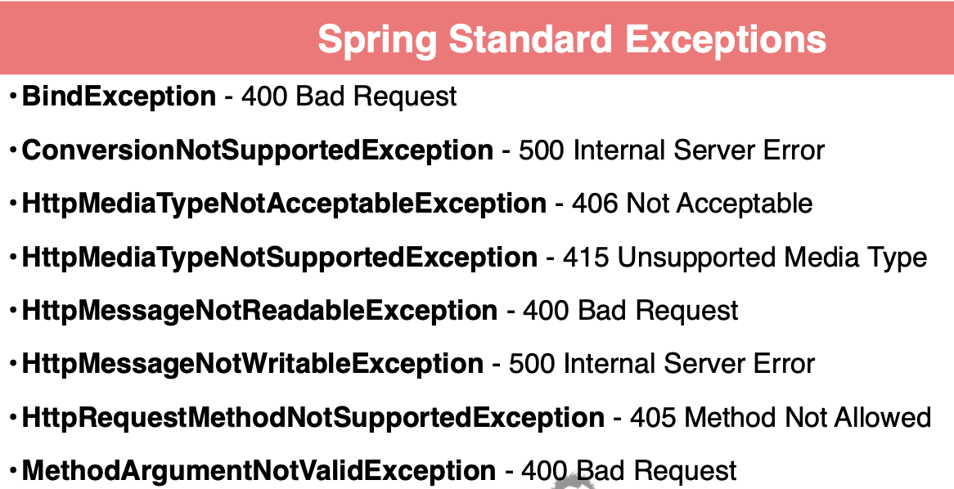
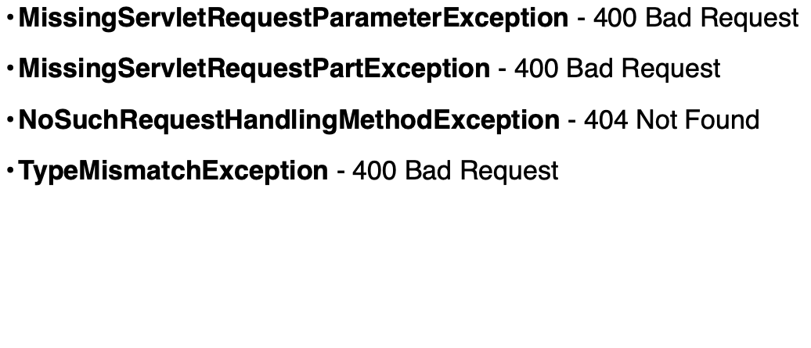
Exception Handling Overview
For a 500 Series error
  Do not leak information to the stack trace
Spring MVC does support a number of standard exceptions
  Spring MVC based robust support for customizing error responses
  Handled buy the DefaultHandlerExceptionResolver
    Does not write content to the body of the response
    Set a status code
Standard Spring Exceptions
Bind Exception -- EX pass a String for a Number or Int value for a UUID
Spring MVC Exception Handling
  @ExceptionHandler on controller method to handle specific Exception
  types
  @ResponseStatus – Annotation sets http status
  @Controller Advice – Used to implement a global exception handler
  ResponseStatusException Class – A thrown exception which allows setting HTTP Status and message in constructor
  AbstractHandlerException Resolver – full control over response including body

Slide 44
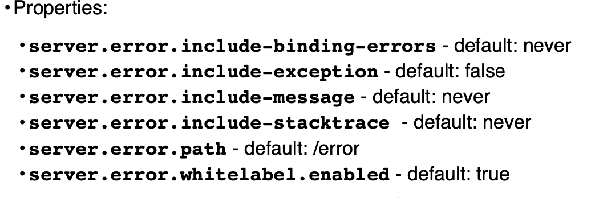
Spring Boot Error Control
provides a whitelabel error page for HTML requests of JSON response for restful requests
Srping Boot BasicErrorController – Rarely used
  Extended for additional error response customization
  wide support of needs of various clients and situations
  Rarely used.
Optional
  Using the optional in the controller – cleaner implementation. The controller not the service decides how the exception should be returned

Slide 45
Exceptions : Throw Custom Exception with Mockito
Example
  @Test
  public void getBeerByIdNotFound() {
    given(beerService.gegtBeerById(any(UUID.class))).willThrow(NotFoundException.class);
    mockMvc.perform(get(“/api/v1/beer”), UUID.randomUUID())
    .andExpect(status().isNotFound());
  }

Slide 46
Using Exception Handler
Controller Advice
Example – Inside a controller class and and NotFoundException will execute this code
  @ExceptionHanlder(NotFoundException.class) // Can have one or more classes
  public ResponseEntity handleNotFoundException() {
    return ResponseEntity.notFound().build();
  }
Controller Advice
  Example
    @ControllerAdvice // All controllers are able to use this class
    pubic class ExceptionController {
      @ExceptionHanlder(NotFoundException.class) // Can have one or more classes
      public ResponseEntity handleNotFoundException() {
      return ResponseEntity.notFound().build();
      }
    }

Slide 47
Exceptions – ResponseStatus
For Rest the HttpStatus is the primary value need
@ResponseStatus has two parameters ( Http Status Code ) and NotFound

Slide 48
Spring DTO
Data Structures which do not have behavior, but transfer data between producers and consumers
Why not use entities
  Spring data Rest exposes database entities directly can be used for simple project
  Database entities can leak data to the client tier
  Separations – As the application become more and more complex separation become more and more important
    The needs of the consumer are different than the need of the persistence
    See the divergence between what the web tier needs and the persistence tier needs
  DTO can be optimized for JSON serialization and deserialization
  With DTO you can separate classes in the backend and send them as one Data Structure to the front end
    Ex. Lets say you have customer and beer then you can keep separate in the backend and Create a class that combines them to send to the front end
Type Conversions
  Best Practice is to used dedicated converters ( single Responsibility Principle )
    service should not be doing type conversions
  Spring Framework provides a Interface called Converter with generics which can be used with the Conversion Service
  MapStruct is a code generator which automates generation of type converters

Slide 49
Spring DTO
Spring Data JPA Dependencies
Creating JPA Entities
Hibernate UUID id Generation
    Code Generator
    Provide the interface and MapStruct generates the code
    Work with annotations
    Has good spring integration can generate Spring Converters and Components
    Inject into services
Spring Data JPA Dependencies : org.springframework.boot:spring-boot-starter-jpa / com.h:h2database:h2
Creating JPA Entities
  @Version – Compare the version in the instance to the version column in the database and if different throws an exception
Hibernate UUID
  UUID – Infinite number of possibilities and more performant since the event space is huge
  @GenericGenerator – Hibernate specific generation which contains one parameter name and strategy
    @GenericGenerator( name = “UUID”, strategy = “org.hibernate.id.UUIDGenerator”)

Slide 50
Spring Boot JPA Test Splice
Spring Boot JPA Test Splice
  @DataJpaTest // Autowiring a controller would cause it to fail
  class BeerRepositoryTest {
    @Autowired BeerRepository beerRepositoryTest;
    @Test
    void testSaveBeer() {
      Beer savedBeer = beerRepository.save(Beer.builder().beerName(“My Beer)).build();
      assertThat(savedBeer).isNotNull();
      assertThat(savedBeer).getId()).isNotNull();
    }
  Testing sever items
    will have a beer repository in the spring context
    SpringBoot Bring up a minimal database context
      Hibernate will do reflection on the two created entities to brings thing in
    The H2 memory db will be initialized by hibernate
    The injected repository will save the new beer and verify that the assertions will prove there is an id.
  Every time a test completes then Spring will do rollback to make sure the data is in the original state

Slide 51
MapStruct Dependencies and Configuration
Maven
  declare property for org.mapstruct.version
  dependency: org.mapstruct:mapstruct:<property version>
  <plugin>
    <groupId>org.apache.maven.plugins</groupId>
    <artifactId>maven-compiler-plugin</artifactId>
    <version>3.10.1</version>
    <configuration>
      <source>17</source> // Define the java versions for source and target
      <target>17</target>
      <annotationProcessingPaths>
        <path>
          <groupId>org.progject.lombok</groupId> <artifactId>lombok</artifactId> <version>${lombok.version}</lombok>
        </path>
        <path>
          <groupId>org.mapstruct</groupId> <artifactId>mapstruct-processors</groupId> <version>${org.mapstruct.version}</version>
        </path>
        <path>
          <groupId>org.projectlombok</groupId> <artifactId>lombok-mapstruct-bindings</groupId><version>0.2.0</version>
        </path>
        <compilerArgs> // Arguments for the compiler
          <compilerArg>-Amapstruct.defaultComponentModel=spring</compilerArgs // create classes with @Component
        </compilerArgs>
      </annotationProcessingPaths>
    </configuration>
    <plugin>

Slide 52
MapStruct Mappers
Create interface
  @Mapper
  public interface BeerMapper {
    Beer BeerDtoToBeer(BeerDTO dto);
    BeerDTO BeerToBeerDto(Beer beer)
  }

Slide 53
JPA Services
JPA Get Operations
Controller Integration Test
Get a list of instances
  beerRepository.stream.map(beerMapper::beerToBeerDto).toList();
Get by Id
  Optinal.ofNullable(beerMapper.beerToBeerDto(beerRepository.findById(id)).orElse( return null);
Integration Test
  @SpringBootTest – Bring up the full context not just a splice
  Example Problem with Integration test the data is changed permanently in order to avoid this use
    @Rollback
    @Transacitonal
    @Test
    void testEmptyList() {
      beerRepository.deleteAll()
      List<BeerDTO dtos = beerController.listBeers();
      assertThat(dtos.size()).isEqualTo(0);

Slide 54
Save New Beer
Update a Beer
Save an object
  return beerMap.beerToBeerDto(beerRepository.save(beerMapper.beerDtoToBeer(beer)));
update an object
// Cannot do any updates outside the lambda function
AtomicReference<Optional<BeerDTO>> atomicReference = new AtomicReference<>();
beerRepository.findById(beerId).ifPresentOrElse(
foundBeer -> {
foundBeer.setBeerName(beerDTO.getBeerName()); foundBeer.setBeerStyle(beerDTO.getBeerStyle());
foundBeer.setUpc(beerDTO.getUpc()); foundBeer.setPrice(beerDTO.getPrice());
atomicReference.set(Optional.of(beerMapper.beerToBeerDTO(beerRepository.save(foundBeer))));
},
() -> { atomicReference.set(Optional.empty()); } );
return atomicReference.get();
When checking for existing using a Repository check for existId since that will not create the POJO and waste time and resources.

Slide 55
Overview of Java Bean Validation
Making assertions against data to ensure data integrity
Should be happening at every exchange
  User Input Data
    Don’t call the API if the data is bad
  Should be validated early in the controller before the service layer
  Should be validated before going to the database layer
    Database Constraints will enforce data validation
Java Bean Validation ( changed to Jakarta Bean Validation )
  Java Standard which provides a standard way of performing validation and handling errors ( JSR 303)
    much more graceful than if-blocks and exceptions
    An API
    Primary focus was to define annotations for data validation
      Originally -- largely field level properties, but later expanded to validate input parameters
      Does dependency injection for Bean Validation Components
      Use Java 8 language features

Slide 56
Overview of Validation
@Null, @NotNull, @AssertTrue, @AssertFalse, @Min, @Max
@DecimalMin, @DecimalMax, @Negative, @NegativeOrZero, @Postive, @PositiveOrZero,
@Size ( check if string or collection) is between min and max
@Digits – Check for integer digits and fraction digits
@Past, @PastOrPresent,@Future, @FutureOrPresent – Compare Dates
@Pattern
@NotEmpty – Checks if value is null or empty
@NonBlank – Checks String is not null or whitespace characters
@Email

Slide 57
Overview of Validation
Hibernate does have some specific Constraints
  @ScirptAssert class level annotation checks class against script
  @CreditCardNumber
  @Currency
  @DurationMax – Duration less than given value
  @DurationMin – Duration greater than given value
  @EAN –Valid EAN Barcode
  @ISBN valid ISBN value
  @Length – String length between a min and max
  @CodePointLength – Validate that code point length of the annotated character sequence is between min and max included
  @Luhncheck – Luhn check sum
  @Mod10Check – Mod 10 Check sum
  @Mod11Check – Mod 11 Check sum
  @Range – checks if number is between given min and max inclusive
  @SafeHtml
  @UniqueElements
  @Url

Slide 58
Overview of Validation
Validation and SpringFramework
  Validation support can be used in controllers and services and other Spring Managed Component
  Spring MVC will return a 400 ( Bad Request ) Error for validation features
  Spring Data JPA will throw an exception for JPA constraint violations
  SpringBoot will autoconfigure validation when the validation implementation is found in the classpath
    If API is only on classpath ( with no implementation) you can use the annotations, but validation will not happen

Slide 59
Java Bean Validation Maven Dependencies
Controller Binding Validation
Custom Validation Handler
Dependencies
  org.springframework.boot:spring-boot-starter-validation
Controller Binding Validation
  In the Beer DTO
    @NotNull
    @NotBlank
    private String beerName;
  In the BeerController add the @Validate to alert the framework that validation needs to be done.
    public ResponseEntity handlePost(@Validated @RequestBody BeerDTO beer)
Custom Validation Hanlder
  Can set mockMvc.perform returns a MockSet which has its own functions

Slide 60
JPA Validation
Database Constraint Validation
For the repository tests
  Without this function, the test will pass even though there are constraints issues.
    Problem: It running so quickly, but the session is ending to quickly
    Solution: Use beerRepository.flush() to immediately write to disk
  Put the validations in both the DTO and the Model so that different layers can validate ( ex. service layer can validate when a beer has been patched)
Best Practice : Don’t hit the database unless all the data is validated
Database Constraint Validation
  Default Behavior of hibernate set string properties to 255
  How do we change the size of the String
    Use @Column(length = 50)
    @Size(max=50) would even be better since we don’t try to save data to the database unless it has been validated.

Slide 61
Controller Testing with JPA
Controller Testing with JPA
  Example
    @AutoWired WebApplicationContext wap;
    Mockmvc mockMvc;
    @BeforeEach0
      void setUp() { mockMvc = MockMvcBuilders.webAppContextSetup(wac).build()
        Setup the Spring Web Application environment with the Data Repositories which is full Spring Boot Test
  For this test we are using the Patch
    However patch requires a Hash Table for the maps
    @Validated will not be used with Hashtables so at the controller level the changes will not be validated
      In the current solution the changes to the Beer Instance will not be validated
      Which means saving the object could cause a constraint problem in the database.

Slide 62
JPA Validation Error Message
Step 1
  Add an exception handler to the CustomErrorControl
    Example
ResponseEntity handleJPViolations(TransactionSystemException exception) {
ConstraintViolationException constraintViolationException = (ConstraintViolationException) exception.getCause().getCause();
List errors = constraintViolationException.getConstraintViolations().stream().map( constraintViolation -> {
Map<String, String> errorMap = new HashMap<>();
errorMap.put(constraintViolation.getPropertyPath().toString(), constraintViolation.getMessage());
return errorMap;
}).toList();
return responseEntity.body(errors);
}
return ResponseEntity.badRequest().build();
}

Slide 63
JPA Validation Error Handler

Slide 64
Annotations -- Database
@Entity
@id
  @GeneratedType The strategy used to generate the unique key
  @GeneratedValue(generator="UUID")
  @GenericGenerator(name = "UUID", strategy = "org.hibernate.id.UUIDGenerator")
@Jointable Which Tables to join
  @Join Column the column that will do the joining
@Version – Part of the locking Strategy where every update is incremented by 1.
  If the instance value is different from the database then some other application or thread overwrote it.
@Column(length = 36, columnDefinition = "varchar", updatable = false, nullable = false)
@Transaciotnal, @Rollback

Slide 65
Spring and Spring Boot Annotations
@autowired, @Primary, @Qualifier, @Profile, @ActiveProfile, @Component, @Bean
@Controller, @Service, @Component, @Repository, @RestController
  @RestController – returns responseBody -- object returned is automatically serialized into JSON and passed back into the HttpResponse object.
@RequestMapping, @PathVariable(name of Path Variable), @ResponseBody
  @RequestBody – Deserializes the HTTP Request Body into a Data Transfer Object.
@GetMapping, @PostMapping, @PutMapping, @DeleteMapping, @PatchMapping
@ExceptionHandler, @ControllerAdvice, @ResponsseStatus
  @ResponseStatus(value = HttpStatus.NOT_FOUND, reason="The primary key was found in the data structure or database")
@DataJpaTest, @SpringBootTest, @WebMvcTest
  @SpringBootTest – Used for integration test ( Testing the controller as if it was the spring framework, but don’t have the webcontex
  @DataJpaTest, @WebMvcTest – Used for unit testing.
@Validated ( Can be on a parameter or field ), @NotBlank, @NotNull

Slide 66
Others
MapStruct
  @Mapper
  When the compile task is execute mapstrcut will generated the code found in the interfaces annotated with @Mapper
  create functions that can convert from DTO and to DTO
ObjectMapper

Slide 67
Mockito Annotations and Extra
@MockMvc
@MockBean
@Captor
given().willRetrun()
verify(Interface).delete(argment.capture())
  uuidArgumentCaptor.getValue()
mock.perform( get(<uri>, path Variables )
  .accept
  .andExpect status.isOk(), contentType(), header.exists(“location”)
    jsonPath( $.metadata.id”, is(cusotmer.getMetaData().getId())
  For adding content: contentType, content
    ObjectMapper.writeValueAsStriong

